Slide 1
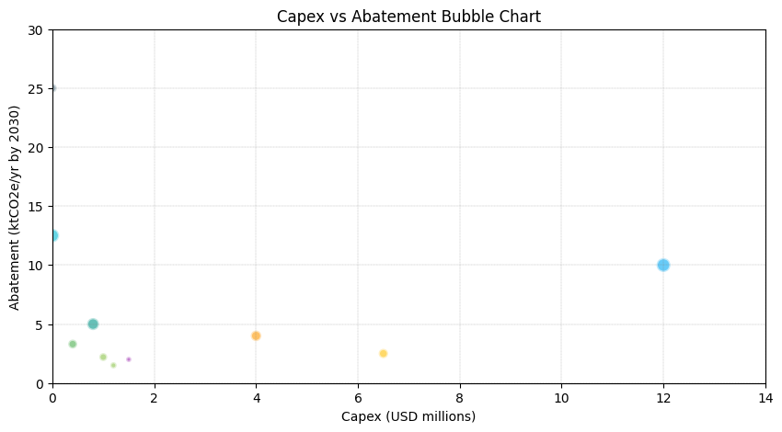
Economics: Capex, Opex, Payback
Wacc percent: 8
Power price usd per mwh: 55
Gas price usd per mmbtu: 6
Carbon shadow price usd per t: 75
Escalation percent per year: 2
LED + controls: Capex musd: 1.2, Annual savings musd: 0.25, Abatement ktco2e: 1.5, Simple payback years: 4.8, Notes: Utility rebates up to 20% capex
VFDs & motor optimization: Capex musd: 1, Annual savings musd: 0.4, Abatement ktco2e: 2.2, Simple payback years: 2.5, Notes: ISO 50001 alignment
Compressed air program: Capex musd: 0.4, Annual savings musd: 0.5, Abatement ktco2e: 3.3, Simple payback years: 0.8, Notes: Leak remediation + controls
On-site PV (5 MWdc + 2 MWh): Capex musd: 6.5, Annual savings musd: 0.55, Abatement ktco2e: 2.5, Simple payback years: 8, Notes: 48E ITC 30% can reduce net capex to ~$4.55M
VPPA (50 GWh/yr, 10-yr): Capex musd: 0, Annual savings musd: 1.15, Abatement ktco2e: 12.5, Simple payback years: 0, Notes: Strike ~$32/MWh vs BAU $55/MWh
Process electrification: Capex musd: 12, Annual savings musd: 1.2, Abatement ktco2e: 10, Simple payback years: 10, Notes: Subject to tariff demand charges; mitigate via thermal storage
Waste heat recovery: Capex musd: 4, Annual savings musd: 0.7, Abatement ktco2e: 4, Simple payback years: 5.7, Notes: Eligible for industrial efficiency grants in some regions
Fleet electrification: Capex musd: 1.5, Annual savings musd: 0.18, Abatement ktco2e: 2, Simple payback years: 8.3, Notes: Charger incentives may improve payback
Logistics optimization: Capex musd: 0.8, Annual savings musd: 0.9, Abatement ktco2e: 5, Simple payback years: 0.9, Notes: TMS + mode shift to rail where possible
Supplier program (opex): Capex musd: 0, Annual savings musd: 0, Abatement ktco2e: 25, Simple payback years: None, Notes: Opex ~$2M/yr for engagement, audits, data; ROI via resilience and CBAM/ESG premium

